Slide 1
A Pitch to Create a Social Impact Technology Incubator
Becca Williams | becca@thoughtdistillery.co

Slide 2
This Just In
“Why It’s Time to Finally Worry about ESG” – HBR
“Large asset management firms and pensions funds are now pressuring corporate leaders to improve sustainability practices in material ways that both benefit their firms’ bottom line and create broader impact.”
“Generation closes $1B growth fund targeting sustainable startups” – TechCrunch
“We believe that we are at the early stages of a technology-led sustainability revolution,” said Al Gore, Chairman and Co-Founder, in a statement, “which has the scale of the industrial revolution, and the pace of the digital revolution.”
Notes:
This is trending. Not in a shallow, here today, gone tomorrow fashion, but as a tipping point.
Opportunity to get ahead of the curve
Seeing big headlines around sustainability and social impact daily
Much research focusing on consumers, Millennials
Only a matter of time before we see that trickle into B2B and from a recruiting perspective, we are likely already impacted in some way, whether or not we know it
I predict that HCD 2.0 is going to be social impact design (or we'll see a brand-new niche, already seeing circular design from a manufacturing/economic perspective)
ESG – Environmental, Social, Governance criteria

Slide 3
Critical Questions
How might we further differentiate ourselves in a crowded market with a strong unique value proposition?
How might we attract and retain mission-driven top talent?
How might we maintain employee engagement and sense of purpose while on the bench?
How might we become the go-to application development firm for social impact investors, founders, institutions and accelerators alike?
How might we evolve our brand story in a purpose-led fashion?
How might we help impact founders build MVPs and POCs that would otherwise be difficult to fund?
How might we apply Circular Design to software development?

Slide 4
Why?
Enhance brand story => UVP
Position company as one not afraid to experiment; a company that cares
Grow/expand mindsets
Attract new talent
Build relationships with social impact investors and founders that can drive other business opportunities beyond the friends of company network
Improve employee engagement
Keep our folks on the bench productive even when not directly generating revenue
Continue to refine model for POCs and MVPs
Test out new methods and technologies in a controlled environment
Notes:
Professional services can feel heartless; people are resources; commodified to some degree
Eventually that’s going to catch up to us
Especially Millennials are really seeking companies with clear purpose, strong track record of social benefit; Millennials will be making more and more buying decisions
Candidates screening out potential employers based on evolving criteria, including social impact, DE&I

Slide 5
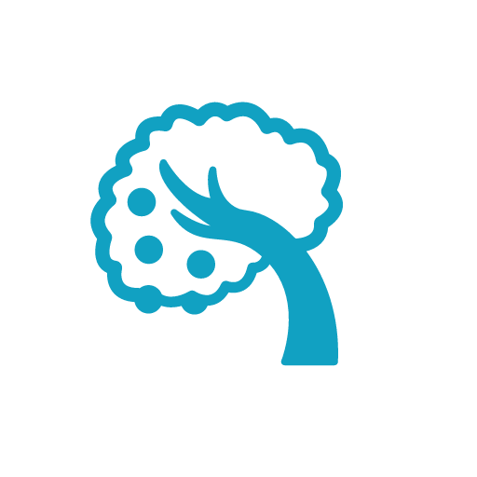
Low-hanging Fruit
Create a placeholder “Social Impact” page on website, capturing email addresses and analytics to measure interest
Ask our biggest accounts and board members about the importance of social impact to them
Conduct interviews with impact founders, investors and accelerator leaders to validate market need
Host a tech Q&A/virtual coffee talk for non-technical social impact founders

Slide 6
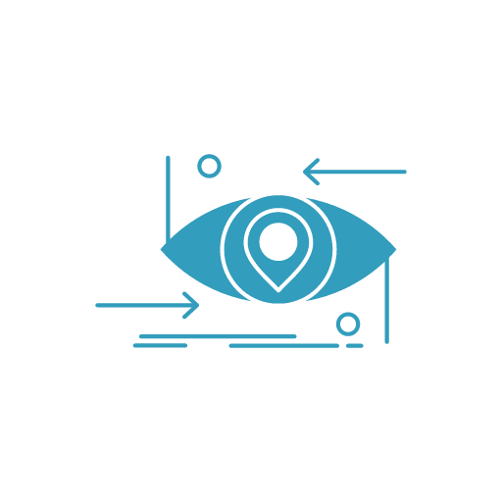
The Future
Build out a highly inclusive dream team across abilities, gender, generations, sexual orientations, and ethnicities
Take on one socially-conscious AppDev project/quarter for the next year after initial success
Pursue B Corp certification for this autonomous business entity under the corporate umbrella and/or consider B Corp certification for company as a whole
Create a conference/network for social impact tech founders
Create a US-based apprenticeship for social impact in tech with a focus on attracting underrepresented talent
Develop expertise in environmentally sustainable DevOps practices

Slide 7
Success Criteria/Hypotheses to Test
After 6 months, we’ll decide to continue the program
Excitement is generated internally, with our partners, and our investors
Referrals will increase by x%
The AppDev revenue stream will grow by x%

Slide 8
What is Social Impact?
Related Terms
Social Enterprise
Social Entrepreneurship
Conscious Capitalism
Triple Bottom Line – Profit, People, Planet
The Fourth Sector
Corporate Social Responsibility (CSR)
Impact investing
Social Return on Investment (SROI)
Benefit Corporation
Certified B Corp
Circular Design
Environmental, Social and Governance Criteria (ESG)
Notes:
Benefit corporation is a legal structure recognized in around 30 states
B Lab is a certifying body
Circular economy – “Design out waste and pollution
Keep products and materials in use
Regenerate natural systems” - https://www.ellenmacarthurfoundation.org/circular-economy/concept
“Environmental, social and governance (ESG) criteria are a set of standards for a company’s operations that socially conscious investors use to screen potential investments. ” -
https://www.investopedia.com/terms/e/environmental-social-and-governance-esg-criteria.asp

Slide 9
References/Key Points
“How Does My Sector Contribute to Social Impact?” – Classy
“Social impact spans not only the nonprofit industry but also the corporate arena. Nonprofits need to showcase the impact that they are making, what their role is in providing solutions to particular issues, or what they are doing to create sustainable, measurable solutions.
Corporations want to and need to be part of the social impact narrative too, whether that’s through CSR programs, supporting local or national nonprofits financially, or through grants. Consumers are increasingly looking for corporations that are socially minded. Corporations must also showcase the impact that they are making on a community and how they are affecting social change.”
“Purpose Series: A Purpose-Driven Brand Is A Successful Brand” – Forbes
"Companies that want to activate their brand’s purpose need to ask themselves some tough questions: Why does the brand exist? What role does it play in customers’ lives? What challenge does it solve? How would the world be different without it? They will soon discover what makes the company special and can use that to build stronger connections and greater relevance with customers.”
“From me to we: The rise of the purpose-led brand” – Accenture
"Consumers in the United States are no longer making decisions based solely on product selection or price; they’re assessing what a brand says, what it does and what it stands for. They support companies whose brand purpose aligns with their beliefs. And they reject those that don’t, with one in five walking away forever.”
“Consumers’ expectations that brand purpose will align with their values pose a challenge for US companies. But expectations for brand purpose also present an opportunity for companies to build more differentiated, authentic and profitable relationships.”
“The public expectations of your company have never been greater… Every company must not only deliver financial performance, but also show how it makes a positive contribution to society. Without a sense of purpose, no company, either public or private, can achieve its full potential.” Larry Fink, Chairman and CEO of BlackRock, Inc.8

Slide 10
References/Key Points Cont.
“Doing Well by Doing Good: The New Corporate Citizenship” – Deloitte via WSJ
"As a result, corporate citizenship no longer falls simply into a corporate social responsibility (CSR) program, an isolated marketing initiative, or a campaign led by the chief human resources officer. It is now a CEO-level business strategy that can define an organization’s very identity."
"A strong corporate citizenship record can affect more than a company’s brand—it can also affect the bottom line. A longitudinal study of purpose-focused companies found they outperformed their S&P 500 peers by a factor of eight.² The investment community also appears to have taken notice: A 2017 study of 22,000 investment professionals found that 78 percent have increased their investments in CSR-focused firms."
“Why Purpose-Driven Companies Are Often More Successful” – Fast Company
"An organization without purpose manages people and resources, while an organization with purpose mobilizes people and resources. Purpose is a key ingredient for a strong, sustainable, scalable organizational culture. It’s an unseen-yet-ever-present element that drives an organization. It can be a strategic starting point, a product differentiator, and an organic attractor of users and customers.”
“Workforce of the future: The competing forces shaping 2030” – pwc
"In May 2017, PwC commissioned a survey of 10,029 members of the general public (with just over 2,000 surveyed in each of China, India, Germany, the UK and the US). Respondents included workers, retired people, unemployed and students in each country."
"Seventy percent of people globally say they want to work for an organisation with a ‘powerful social conscience’ – up from 65% in 2014.”

Slide 11
References/Key Points Cont.
The 2016 Deloitte Millennial Survey
“Values guide where Millennials work, what assignments they will accept…Millennials want to contribute to the positive impact they believe business has on society, but in so doing, they wish to stay true to their personal values. Seven in ten (70 percent) Millennials believe their personal values are shared by the organizations they work for. This rises to 80 percent among the most senior Millennials and 82 percent for those intending to stay for at least another five years. This is a strong indication that Millennials choose employers whose values reflect their own—a concept reinforced by the finding that, globally, 56 percent of Millennials have ‘ruled out ever working for a particular organization because of its values or standard of conduct.’”
LARRY FINK'S 2019 LETTER TO CEOS: Purpose & Profit – Chairman and CEO, BlackRock
“Unnerved by fundamental economic changes and the failure of government to provide lasting solutions, society is increasingly looking to companies, both public and private, to address pressing social and economic issues. These issues range from protecting the environment to retirement to gender and racial inequality, among others. Fueled in part by social media, public pressures on corporations build faster and reach further than ever before.”
“One thing, however, is certain: the world needs your leadership. As divisions continue to deepen, companies must demonstrate their commitment to the countries, regions, and communities where they operate, particularly on issues central to the world’s future prosperity. Companies cannot solve every issue of public importance, but there are many – from retirement to infrastructure to preparing workers for the jobs of the future – that cannot be solved without corporate leadership.”

Slide 12
References/Key Points Cont.
LARRY FINK'S 2019 LETTER TO CEOS: Purpose & Profit – Chairman and CEO, BlackRock
“Companies that fulfill their purpose and responsibilities to stakeholders reap rewards over the long-term. Companies that ignore them stumble and fail. This dynamic is becoming increasingly apparent as the public holds companies to more exacting standards. And it will continue to accelerate as millennials – who today represent 35 percent of the workforce – express new expectations of the companies they work for, buy from, and invest in.
“Attracting and retaining the best talent increasingly requires a clear expression of purpose. With unemployment improving across the globe, workers, not just shareholders, can and will have a greater say in defining a company’s purpose, priorities, and even the specifics of its business. Over the past year, we have seen some of the world’s most skilled employees stage walkouts and participate in contentious town halls, expressing their perspective on the importance of corporate purpose. This phenomenon will only grow as millennials and even younger generations occupy increasingly senior positions in business. In a recent survey by Deloitte, millennial workers were asked what the primary purpose of businesses should be – 63 percent more of them said “improving society” than said “generating profit.”
Icons via The Noun Project

